Slide 1

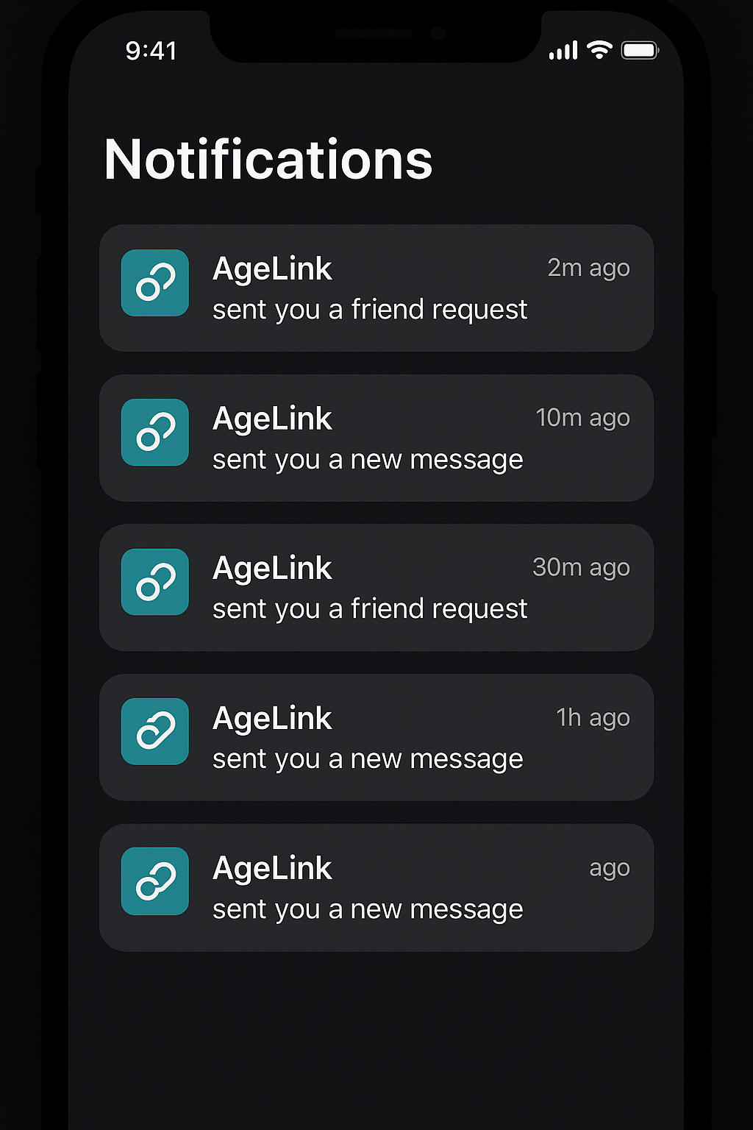
AgeLink: Connecting Older Adults to Their Communities
AgeLink is a lightweight, full-stack web application designed to help older adults stay connected with their local community, volunteers, and shared interest groups, whether virtually or in person. It's built to reduce social isolation and foster engagement among seniors.
Name: Rutvi Keshwani

